Slide 1
Design and Analysis of Algorithms
CS345A
Lecture 36
NP Completeness – I

Slide 2
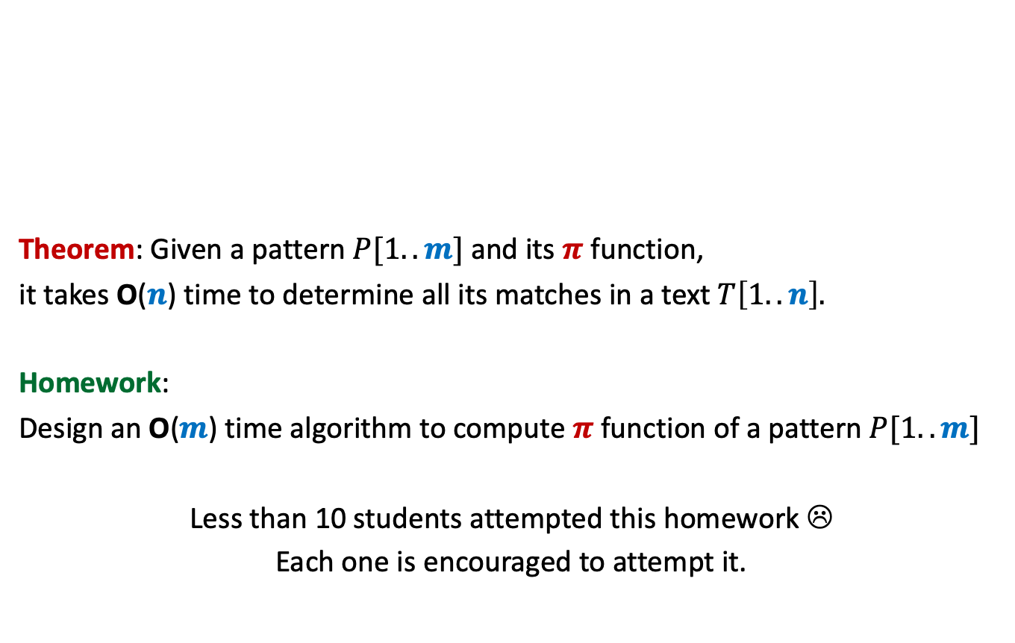
Last Lecture
Theorem: Given a pattern $P[1..m]$ and its $π$function,
it takes O($n$) time to determine all its matches in a text $T\left[1..n\right].$
Homework:
Design an O($m$) time algorithm to compute $π$function of a pattern $P[1..m]$
Less than 10 students attempted this homework ☹
Each one is encouraged to attempt it.

Slide 3



A set of problems discussed in this course
Rounding of Matrix
Bipartite Matching
Airline Scheduling
Transitive closure of graph on $n$ vertices
These appear to be from diverse domains (number theoretic, graphs, …). But did we solve each of them from scratch ?
Maximum ($s,t$)-flow
No.
$n×n$Matrix Multiplication

Slide 4


We reduced one problem to another.
Rounding of Matrix
Bipartite Matching
Airline Scheduling
Transitive closure of graph on $n$ vertices
Maximum ($s,t$)-flow
$n×n$Matrix Multiplication

Slide 5

Polynomial time Reduction
$$A≤_{P}B$$
We shall formally define this reduction in generality.
But, before that, we shall define a class of problem.

Slide 6
Optimization problems versus decision problems
Optimization problem:
Compute maximum flow from s to t in graph G
Decision Problem:
Does there exist a flow of value k from s to t in network G ?
Yes-instances: {(G , k) |there is a valid flow of value k in G}
No-instances: {(G , k) |there is no flow of value k possible in G}
?
How can you use algorithm for the optimization version of a problem to solve its Decision version, and vice versa ?
Try at least for the above example ?

Slide 7
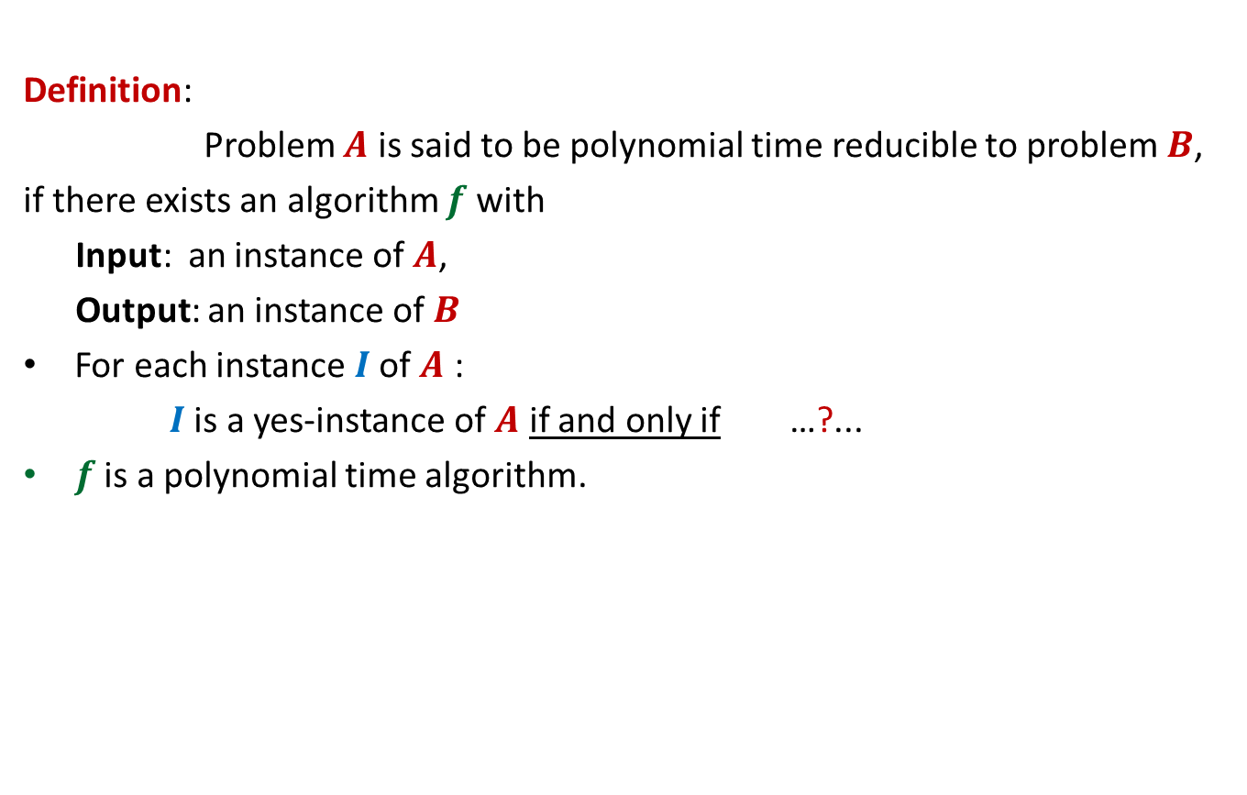


$$A≤_{P}B$$
Definition:
Problem $A$ is said to be polynomial time reducible to problem $B$,
if there exists an algorithm $f$with
Input: an instance of $A$,
Output: an instance of $B$
For each instance $I$of $A$ :
$I$is a yes-instance of $A$ if and only if …?...
$f$ is a polynomial time algorithm.
$f(I)$is a yes-instance of $B$

Slide 8
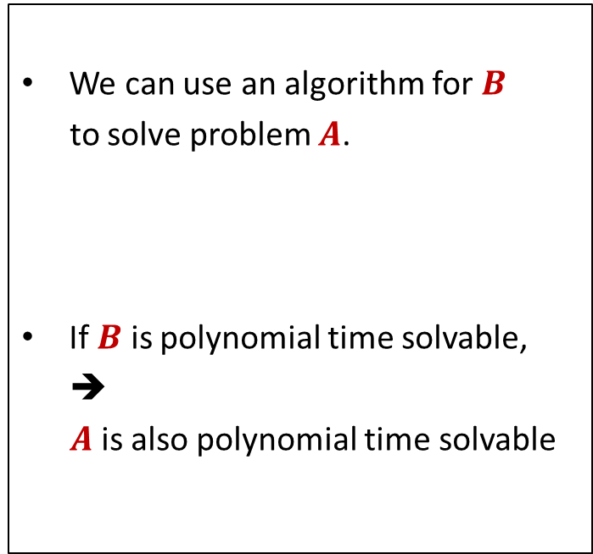

$$A≤_{P}B$$
Algorithmic Consequence
We can use an algorithm for $B$
to solve problem $A$.
If $B$ is polynomial time solvable,
➔
$A$ is also polynomial time solvable

Slide 9
Example 1
Vertex Cover and Independent Set

Slide 10








Vertex Cover
Definition: Given an undirected graph $G=(V,E)$,
a subset $X⊆V$ is said to be a vertex cover if
For each edge $\left(u,v\right)∈E$,
either $u∈X$ or $v∈X$
Optimization version: compute vertex cover of smallest size.
Decision version: Does there exist a vertex cover of size $k$ ?
Is it a vertex cover now ?
Is it a vertex cover ?
$$b$$
Yes.
NO.
Reason:
None of $\left(y,z\right)$
or $\left(y,t\right)$ is covered
$$a$$
$$x$$
$$z$$
$$t$$
$$y$$

Slide 11


Independent Set
Definition: Given an undirected graph $G=(V,E)$,
a subset $X⊆V$ is said to be an independent set if
For each $u,v∈X$ ,
Optimization version: compute Independent set of Largest size.
Decision version: Does there exist an independent set of size $k$ ?
$$\left(u,v\right)∉E.$$
Is it the largest independent set ?
Is it the largest independent set ?
$$b$$
YES
NO.
$$a$$
$$x$$
$$z$$
$$t$$
$$y$$

Slide 12










VC $≤_{P}$ IS
VC: Vertex Cover
IS: Independent Set
Input: an graph $G=(V,E)$ and $k∈Z^{+}$
Problem: Does there exist a vertex cover of size $k$?
Input: an graph $G=(V,E)$ and $t∈Z^{+}$
Problem: Does there exist an independent set of size $t$?
$$b$$
$$b$$
IDEA: Can you see any relation between
Vertex cover and Independent sets of $G$
But your inference could be based on just a coincidence ☹
$$a$$
$$x$$
IDEA: Can you see the relation now ?
$$a$$
$$x$$
$$z$$
$$t$$
$$z$$
$$t$$
$$y$$
$$y$$

Slide 13
VC: Vertex Cover
IS: Independent Set

Slide 14
VC: Vertex Cover
IS: Independent Set
?

Slide 15
VC: Vertex Cover
IS: Independent Set

Slide 16
VC: Vertex Cover
IS: Independent Set

Slide 17

VC $≤_{P}$ IS
Theorem: $X⊆V$ is a vertex cover of $G$ if and only if
$V\backslash X$is an independent set of $G$.
Proof:
➔
⬅

Slide 18
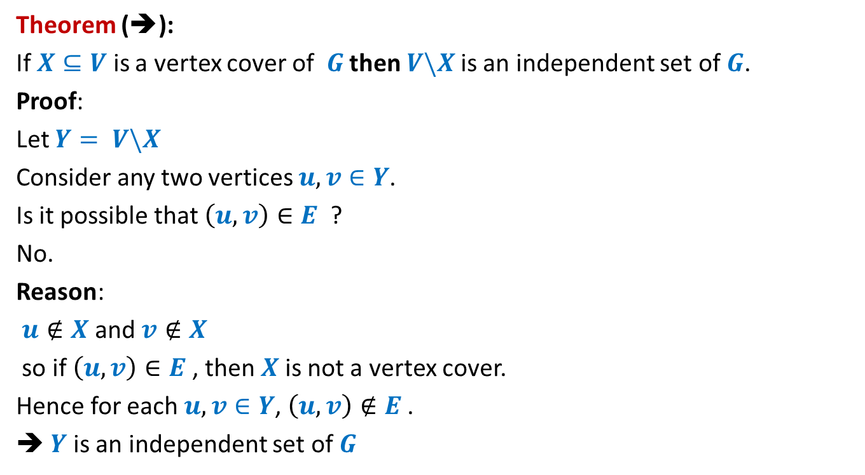
VC $≤_{P}$ IS
Theorem (➔):
If $X⊆V$ is a vertex cover of $G$ then $V\backslash X$is an independent set of $G$.
Proof:
Let $Y= V\backslash X$
Consider any two vertices $u,v∈Y$.
Is it possible that $\left(u,v\right)∈E$ ?
No.
Reason:
$u∉X$ and $v∉X$
so if $\left(u,v\right)∈E$, then $X$is not a vertex cover.
Hence for each $u,v∈Y$, $\left(u,v\right)∉E$.
➔ $Y$is an independent set of $G$

Slide 19
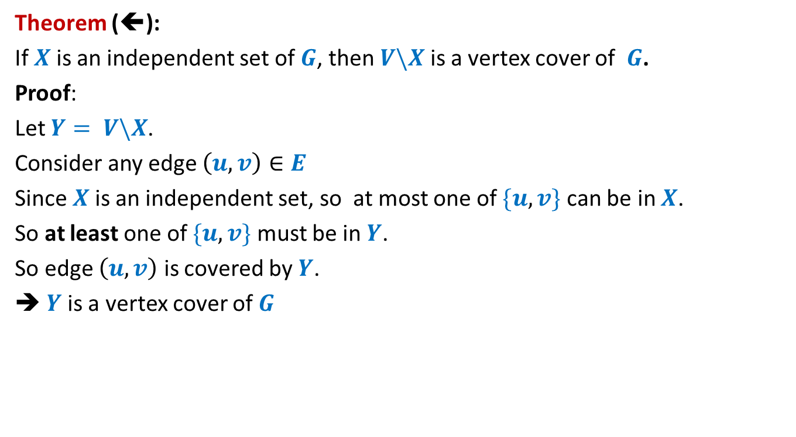
VC $≤_{P}$ IS
Theorem (⬅):
If $X$is an independent set of $G$, then $V\backslash X$ is a vertex cover of $G$.
Proof:
Let $Y= V\backslash X$.
Consider any edge $\left(u,v\right)∈E$
Since $X$is an independent set, so at most one of $\{u,v\}$ can be in $X$.
So at least one of $\{u,v\}$ must be in $Y$.
So edge $\left(u,v\right)$ is covered by $Y$.
➔ $Y$is a vertex cover of $G$

Slide 20
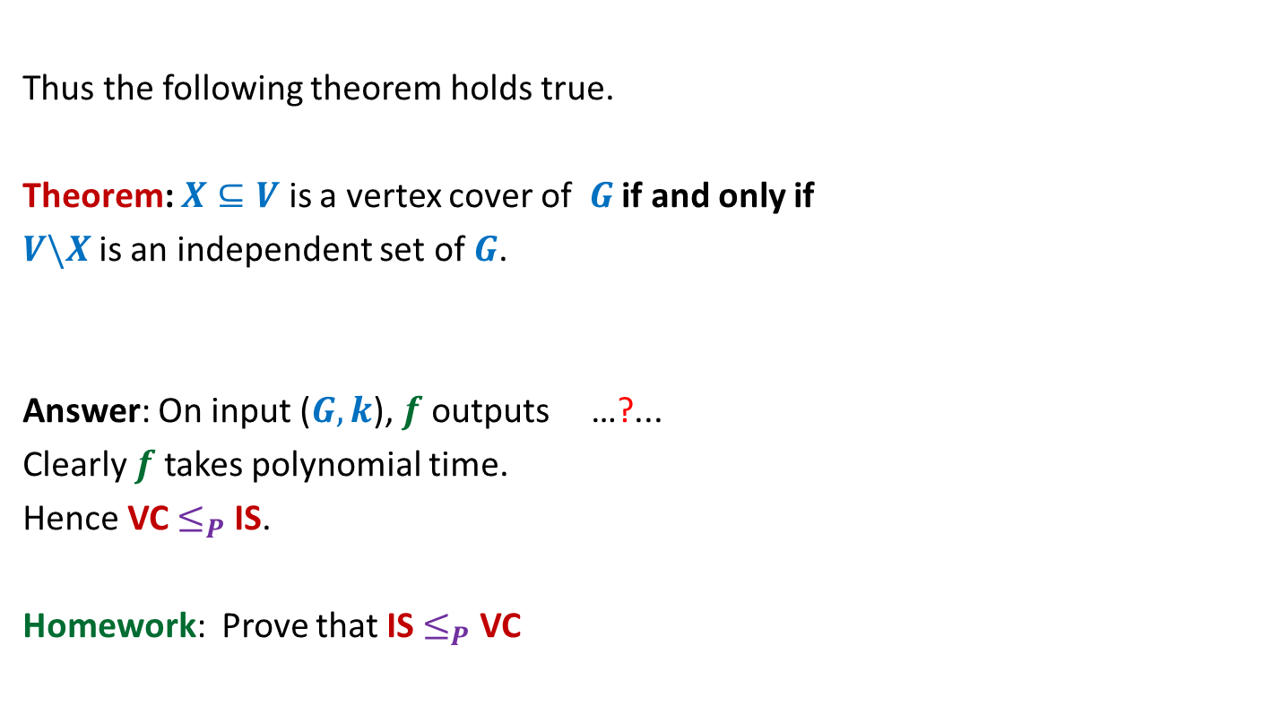


VC $≤_{P}$ IS
Thus the following theorem holds true.
Theorem: $X⊆V$ is a vertex cover of $G$ if and only if
$V\backslash X$is an independent set of $G$.
Answer: On input ($G,k$), $f$ outputs …?...
Clearly $f$ takes polynomial time.
Hence VC $≤_{P}$ IS.
Homework: Prove that IS $≤_{P}$ VC
($G,n−k$).
How to establish VC $≤_{P}$ IS ?

Slide 21
Example 2
Hamiltonian cycle Problem
and
Traveling Sales person Problem

Slide 22

Hamiltonian Cycle Problem
Definition: Given an undirected graph $G=(V,E)$,
a cycle is said to be Hamiltonian if it passes through each vertex.
Optimization version: compute cycle of maximum length.
Decision version: Does there exist a cycle of size $n$ ?
Does it have a Hamiltonian cycle now?
Does it have a Hamiltonian cycle ?
Yes.
NO.

Slide 23

Traveling Sales Person Problem
Definition: In an undirected complete graph $G=(V,E)$ with nonnegative edge-cost,
a tour is a sequence of vertices such that
It originates and terminates at the same vertex
There is an edge between every consecutive pair of vertices in the sequence
Each vertex is visited exactly once.
Cost of tour: sum of cost of edges traversed in the tour.
Optimization version: compute TSP tour of minimum cost.
Decision version: Does there exist a TSP tour of cost at most $b$ ?
33
5
29
This is the minimum cost TSP
tour for this graph.
55
6
8
9
16
25
89

Slide 24



HC $≤_{P}$ TSP
HC: Hamiltonian Cycle
TSP: Traveling Sales Person
Input: An undirected graph
Problem: Does there exist a cycle passing through all vertices ?
Input: An undirected complete graph with non-negative cost on edges and $b∈R^{+}$.
Problem: Does there exist a tour of cost $b$?
IDEA: Build a weighted complete graph $G′$s.t. the Hamiltonian cycle in $G$ turns out to be the least cost tour in $G′$.
33
4
29
55
5
8
9
16
25
89

Slide 25
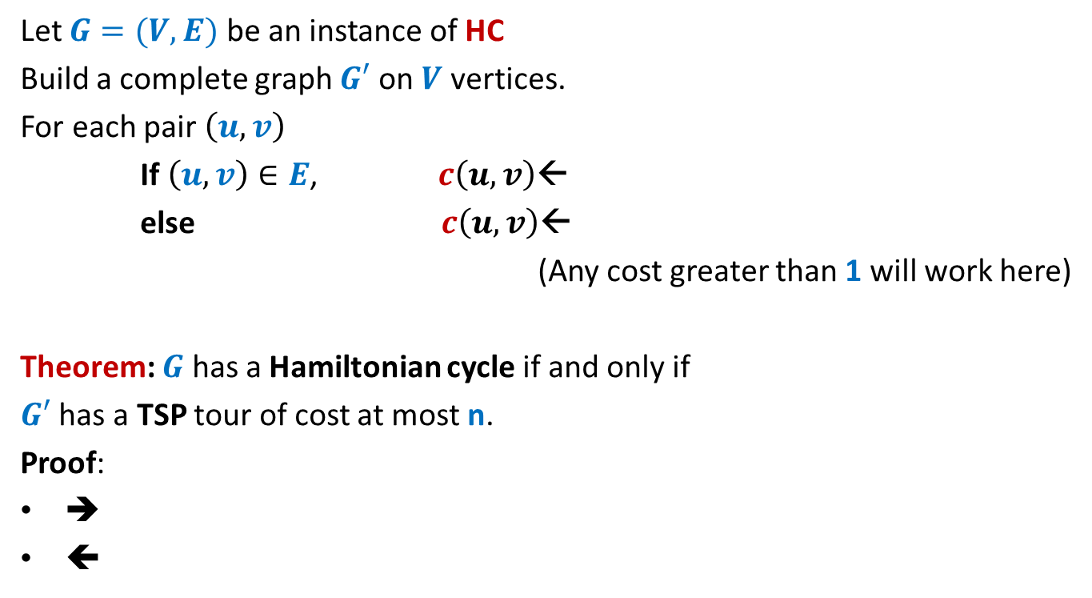
HC $≤_{P}$ TSP
Let $G=(V,E)$ be an instance of HC
Build a complete graph $G′$ on $V$ vertices.
For each pair $\left(u,v\right)$
If $\left(u,v\right)∈E$, $c\left(u,v\right)$←
else $c\left(u,v\right)$←
(Any cost greater than 1 will work here)
Theorem: $G$ has a Hamiltonian cycle if and only if
$G′$ has a TSP tour of cost at most n.
Proof:
➔
⬅
1
2

Slide 26
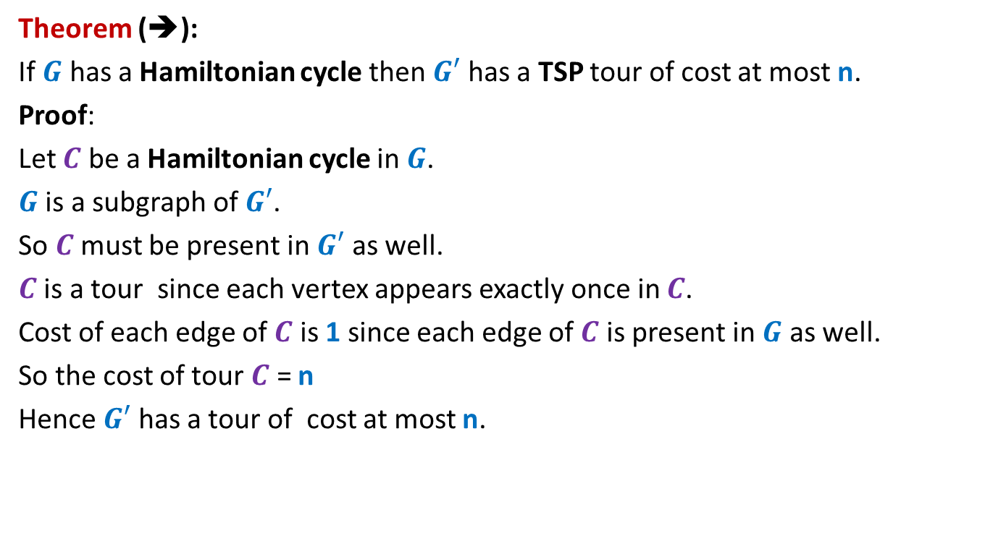
HC $≤_{P}$ TSP
Theorem (➔):
If $G$ has a Hamiltonian cycle then $G′$ has a TSP tour of cost at most n.
Proof:
Let $C$ be a Hamiltonian cycle in $G$.
$G$ is a subgraph of $G′$.
So $C$must be present in $G′$ as well.
$C$ is a tour since each vertex appears exactly once in $C$.
Cost of each edge of $C$ is 1 since each edge of $C$ is present in $G$ as well.
So the cost of tour $C$ = n
Hence $G′$ has a tour of cost at most n.

Slide 27
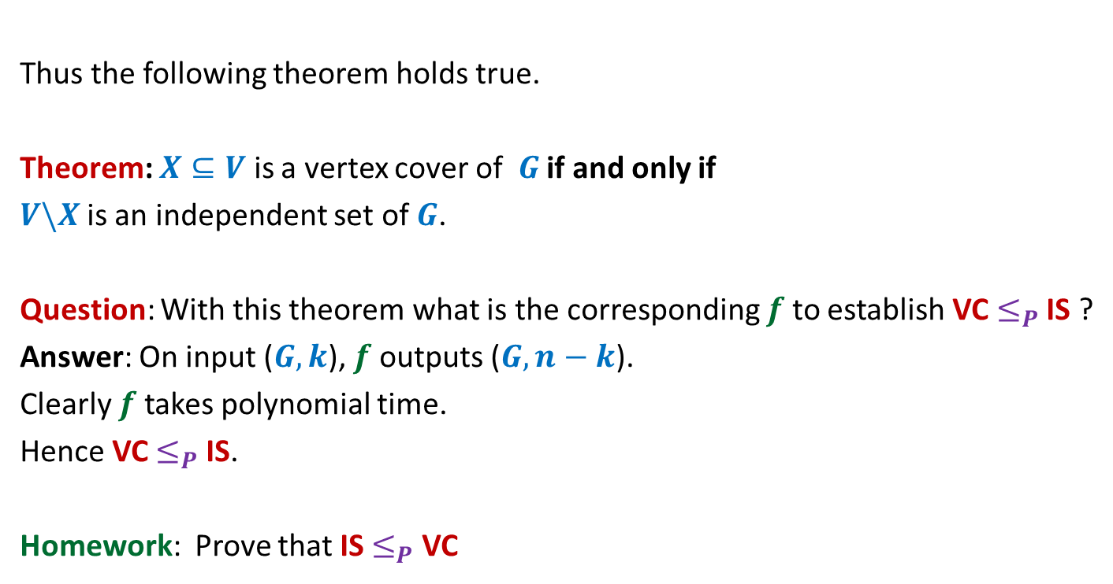
HC $≤_{P}$ TSP
Theorem (⬅):
If $G′$ has a TSP tour of cost at most n, then $G$ has a Hamiltonian cycle.
Proof:
Let $C$ be a TSP tour of cost at most n in $G′$.
Cost of each edge in $G′$ is at least 1.
There are n edges in $C$.
So each edge of $C$must have weight exactly 1.
Therefore, each edge of $C$ is present in $G$ as well.
So $C$ is present in $G$ as well.
Since each vertex appears exactly once on $C$, so $C$ is Hamiltonian as well.
Hence $G$ has a Hamiltonian cycle.

Slide 28
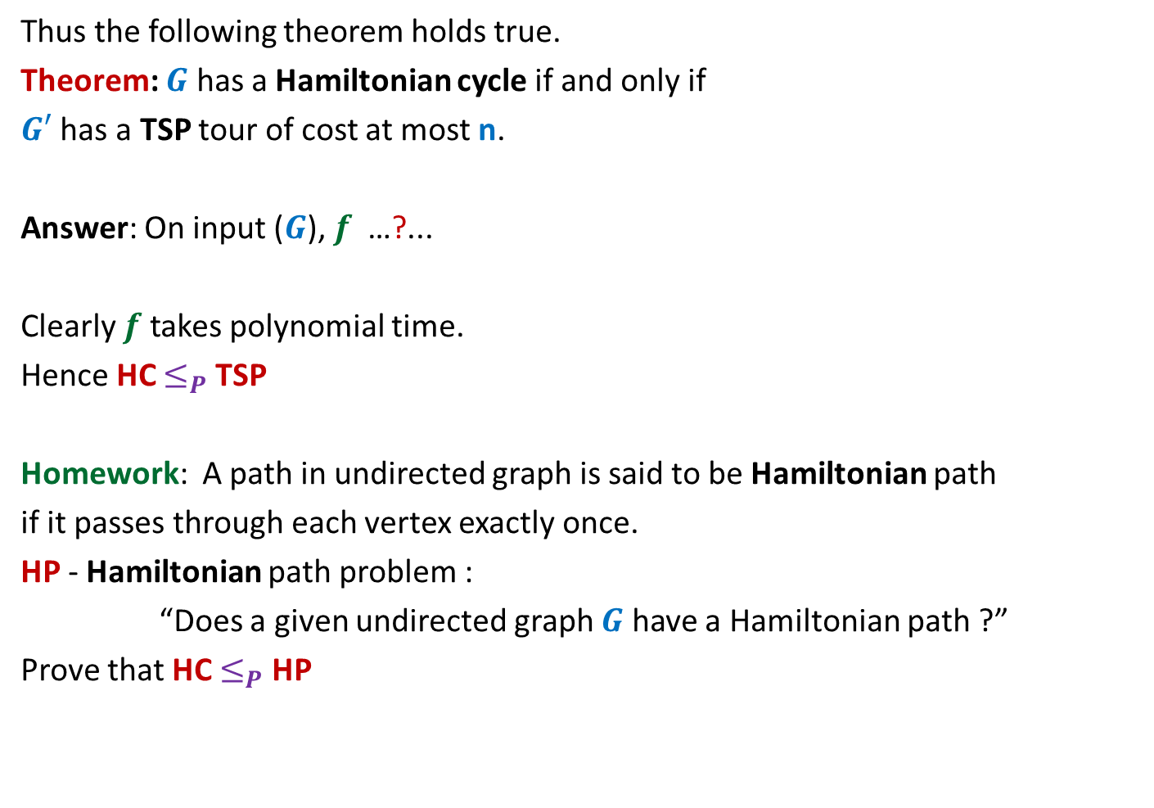
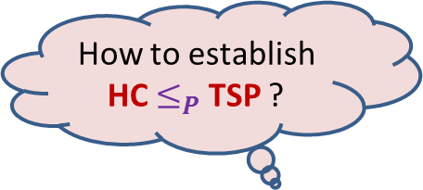
HC $≤_{P}$ TSP
Thus the following theorem holds true.
Theorem: $G$ has a Hamiltonian cycle if and only if
$G′$ has a TSP tour of cost at most n.
Answer: On input ($G$), $f$ …?...
Clearly $f$ takes polynomial time.
Hence HC $≤_{P}$ TSP
Homework: A path in undirected graph is said to be Hamiltonian path
if it passes through each vertex exactly once.
HP - Hamiltonian path problem :
“Does a given undirected graph $G$ have a Hamiltonian path ?”
Prove that HC $≤_{P}$ HP
How to establish HC $≤_{P}$ TSP ?
constructs $G′$ as described above and outputs ($G′,n$).

Slide 29
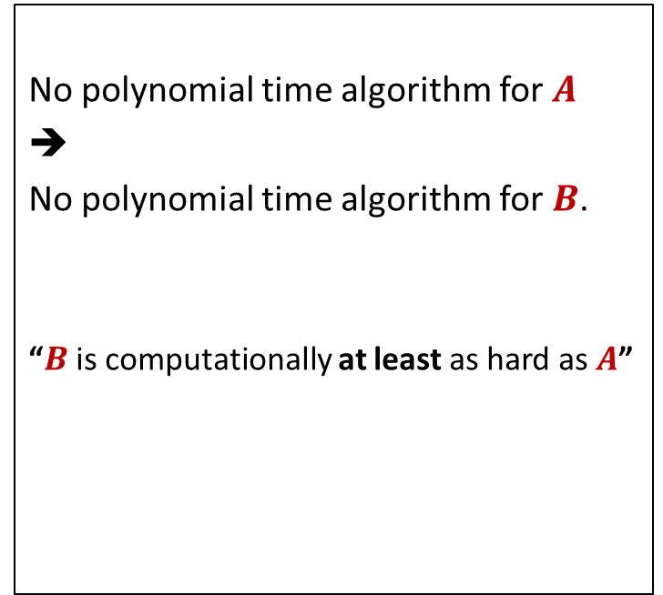
$$A≤_{P}B$$
Algorithmic Consequence
Complexity theoretic consequence
We can use an algorithm for $B$
to solve problem $A$.
If $B$ is polynomial time solvable,
➔
$A$ is also polynomial time solvable
No polynomial time algorithm for $A$
➔
No polynomial time algorithm for $B$.
“$B$ is computationally at least as hard as $A$”

Slide 30
$$A≤_{P}B$$
Complexity theoretic consequence of $A≤_{P}B$:
If there does not exist any polynomial time algorithm for $A$, then
There can not exist any polynomial time algorithm for $B$.
“$B$ is computationally at least as hard as $A$”

Slide 31
NP A class of problems
The story behind its invention…

Slide 32
Go back to 1960’s
Efficient algorithm
was found.
No Efficient algorithm
could be designed till date
This motivated researchers to search for any common traits among all these problems.
Shortest Path
Longest Path
Minimum spanning Tree
Travelling salesman Problem
Euler tour
Hamiltonian cycle
Min Cut
Balanced Cut
Independent Set on trees
Independent Set
Bipartite matching
3D matching
Linear Programming
Integer Linear Programming
…
…
It was quite surprising and even frustrating to be unable to find efficient algorithm for so many problems when their similar looking versions had very efficient algorithms.

Slide 33
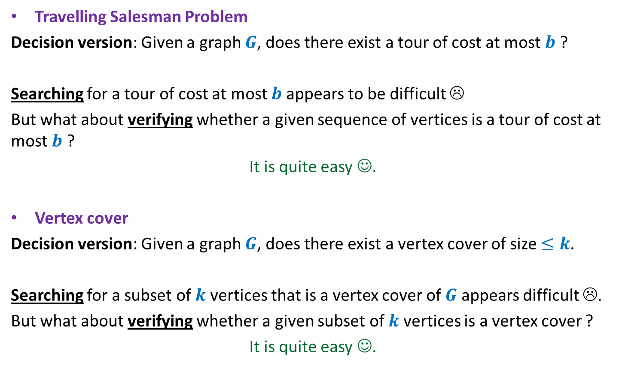
Travelling Salesman Problem
Decision version: Given a graph $G$, does there exist a tour of cost at most $b$ ?
Searching for a tour of cost at most $b$ appears to be difficult ☹
But what about verifying whether a given sequence of vertices is a tour of cost at most $b$ ?
It is quite easy ☺.
Vertex cover
Decision version: Given a graph $G$, does there exist a vertex cover of size $≤k$.
Searching for a subset of $k$vertices that is a vertex cover of $G$ appears difficult ☹.
But what about verifying whether a given subset of $k$vertices is a vertex cover ?
It is quite easy ☺.

Slide 34




What about verifying a proposed solution ?
Easy
No Efficient algorithm till date ☹
Longest Path
Is there a path of length $≥k$ in $G$ ?
Vertex cover
Does there exist a vertex cover of size $≤k$ in $G$?
Travelling salesman Problem
Does there exist a tour of cost $≤c$ in $G$?
Hamiltonian cycle
Does there exist a cycle of length $n$ in $G$?
Independent Set
Does there exist an independent set of size $≥k$ in $G$?
3D matching
…
…
Integer Linear Programming
…

